Slide 1



Digital Dreamers

Slide 2



TABLE OF CONTENTS
1.
2.
3.
Our team
Idea
Process & Technologies
www.DigitalDreamers.com

Slide 3

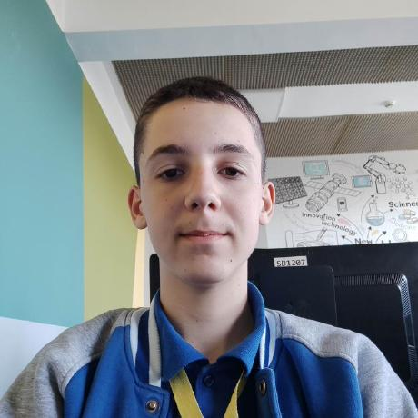
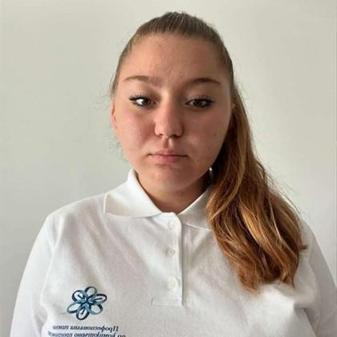
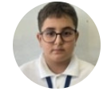
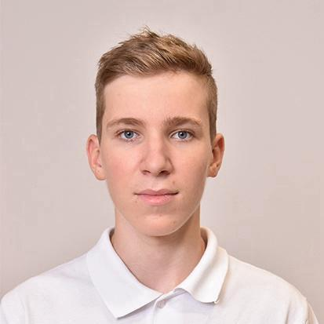
TEAM
Borislav Andrikov
Scrum trainer
Tatiana Kovacheva
Front-End Developer
Rostislav Ivanchev
Back-End Developer
Maksim Iliev
Designer
www.DigitalDreamers.com

Slide 4

Our mission is to create an interactive car rental platform that makes finding and booking a vehicle simple, fast, and enjoyable. Whether you're planning a weekend getaway or need a reliable car for daily use, our platform empowers users to explore options effortlessly. Through smart search tools, users can compare models, prices, and features. For those who want to go further, we offer helpful guides and driving tips to make your rental experience smoother. To bring your choices to life, we also provide interactive 3D car models—making it easier than ever to pick the perfect ride.
IDEA
www.DigitalDreamers.com

Slide 5







USED TECHNOLOGIES & PROCCES
www.DigitalDreamers.com

Slide 6
LET’s continue to our project
www.DigitalDreamers.com

